Slide 1


PROJECT OVERVIEW
AI CareerPilot
A modern AI platform that guides students in choosing the right career, degree, top colleges, and jobs.
Developed By:
Navanish Pandey & Priyanshu Kumar

Slide 2


The Problem
No clarity on career choices
Confusion in selecting stream & degree
Scattered information about top colleges
Unclear job opportunities for specific education
Lack of awareness about scholarships & deadlines
No personalized step-by-step roadmap for careers

Slide 3
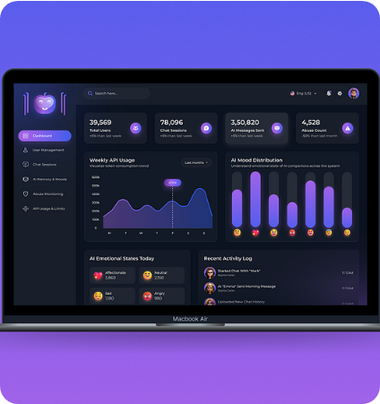
Our Solution
A Centralized AI System
Identifying interests & strengths
Recommending suitable careers
Providing complete step-by-step career roadmaps
Suggesting best streams & degrees
Showing nearby top colleges
Displaying scholarship & admission timelines

Slide 4


System Workflow
User Setup Class, location, language
Path Selection Quiz OR Interest OR Dream Career
AI Recommendation Best-fit careers with required skills
Roadmap Generation Subjects → Degree → Exams → Skills
College Finder Nearby top colleges with details
Scholarship Alerts Eligibility & deadlines
Job Insights Top trending job options
Personal Dashboard Saves progress & notifications

Slide 5












Core Features
Career Recommendation
Backward Career Planner
Top College Finder
Matches user interest & strengths to real-world careers.
Structured roadmap from Job → education → college.
Shows top colleges (Govt+Private) with courses & fees.
Stream & Degree Guidance
Scholarship Alerts
AI Chat Assistant
Helps select the right academic path.
Keeps students updated with admission timelines.
Answers education & career-related queries anytime.

Slide 6


Why Different from ChatGPT?
Domain-Specific
Personalized Dashboard
Focused entirely on student career guidance — not a general chatbot.
Saves careers, colleges, and user progress systematically.
Verified Data (RAG)
Notification System
Uses official government & educational sources to lower hallucination.
Sends admission & scholarship alerts automatically.
Roadmap Comparison
Creates mind-map view for 2–4 saved roadmaps.

Slide 7
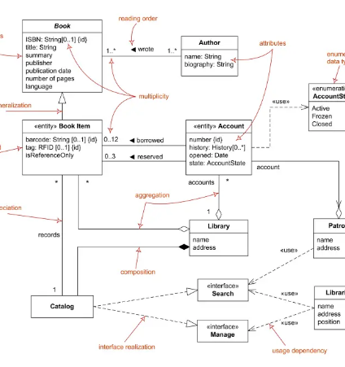
Technical Architecture
Frontend
Backend
• React
• FastAPI (Python)
• Dynamic dashboards
• Modular API architecture
• Geolocation-based map view
• Authentication & user services
AI Layer
Database & Services
• Machine Learning & LLM Engine
• PostgreSQL
• Email Notification (SendGrid)
• RAG (Retrieval-Augmented Generation)
• Vector DB (Chroma/FAISS)

Slide 8
Thank You
Open for Questions

